Slide 1


Investigating Trophic Dynamics in Lake Okeechobee’s Pelagic Zone
Anna Swigris^{1,2} and Corey T. Callaghan¹
¹Department of Wildlife Ecology and Conservation, University of Florida
²South Florida Water Management District
Florida Wildlife Society Conference
April 17th, 2025
Notes:
Specifically, going to be focusing on plankton and nutrient relationships

Slide 2
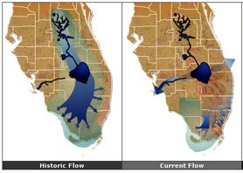
Lake Okeechobee
Lake Okeechobee is a large, shallow lake that has experienced major anthropogenically-driven changes over the last century.
Agriculture → increased levels of nitrogen and phosphorus
Phosphorus-limited system → nitrogen-limited system
Internal loading
Turbidity and light
Dike → limited nutrient export
Notes:
Before I start getting into those specific dynamics, I want to talk about the history of Lake Okeechobee, especially as it relates to nutrients.
Focus on phosphorus, since it so heavily influences lower trophic levels in the ecosystem
Legacy nutrients
Photo: National Park Service courtesy of evergladesrestoration.gov

Slide 3
In Theory…
Energy Transfer
Microzooplankton
Nutrients + Light
Phytoplankton
Planktivorous Fish
Wading Birds, Sportfish, etc.
Macrozooplankton
Notes:
How do nutrients relate to wildlife populations? Here is a quick look at energy transfer in the pelagic zone.
Planktonic organisms serve as the energy links between nutrients/nutrient pollution and wading birds. Further, zooplankton serve as regulators of phytoplankton dynamics.
Is this really the relationship our planktonic components have in the system?
Do zooplankton function as essential energy links in Lake Okeechobee’s pelagic zone?
Let’s take a closer look at these organisms.

Slide 4
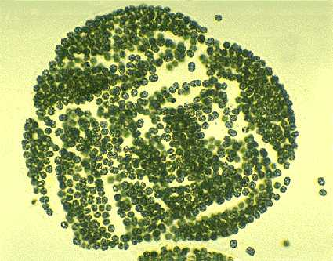
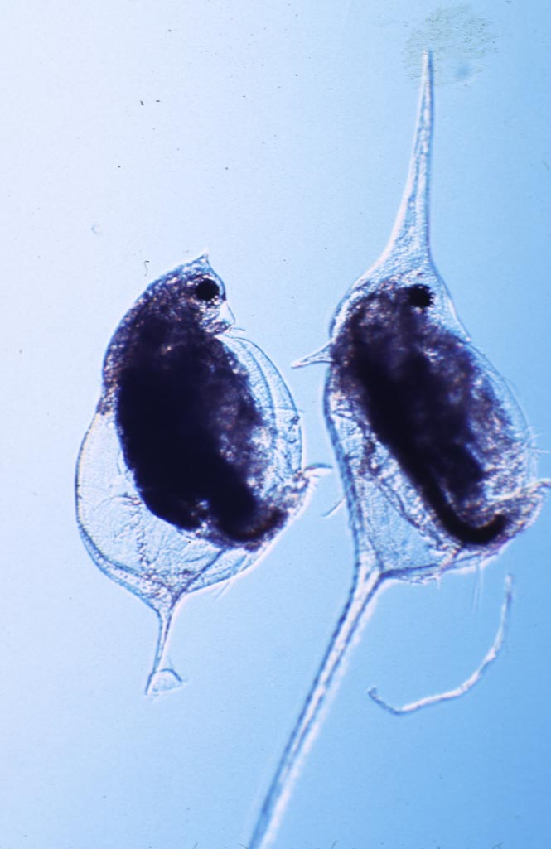
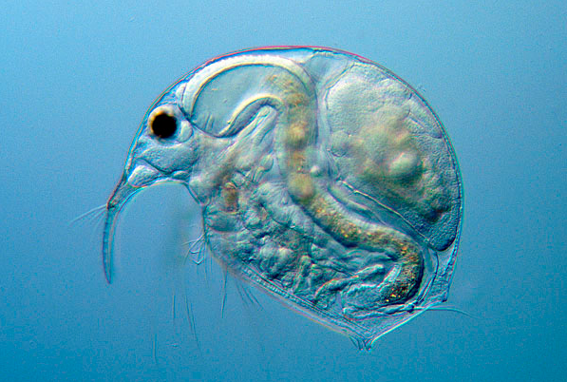
Plankton
Zooplankton and phytoplankton
Phytoplankton are photosynthetic, floating organisms that respond quickly to changes in nutrients and light.
Base of pelagic trophic web
Harmful algal blooms
Chlorophyll-a
Zooplankton are non-photosynthetic organisms that float in the water column
Filter feeders
Microzooplankton and macrozooplankton
Notes:
Subtropical, eutrophic, nitrogen-limited systems tend to yield more of a cyanobacteria-dominated phytoplankton community
Zooplankton will eat whatever will fit into their mouths- phytoplankton, other zooplankton.

Slide 5
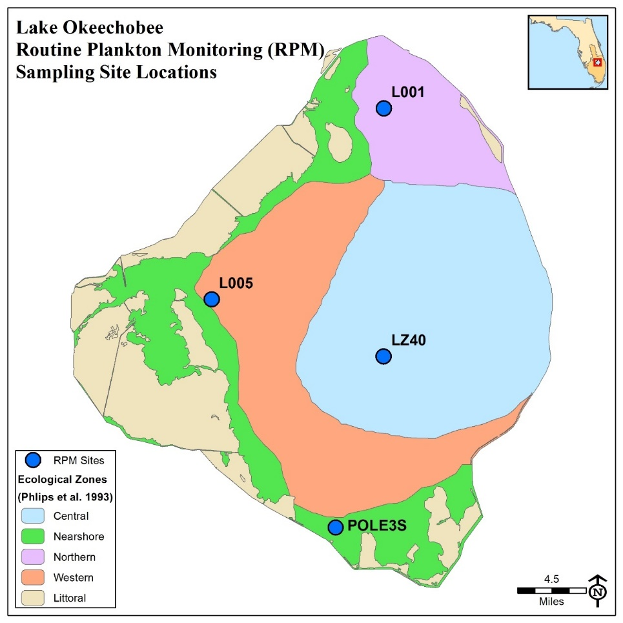
The Project
Routine Plankton Monitoring = long-term plankton monitoring effort initiated by SFWMD in 1994
Sampling frequency change: Quarterly → Monthly
Data Range: January 2023 → December 2024
Parameters:
Phytoplankton (Chl-a)
Zooplankton
Microzooplankton (including nauplii)
Macrozooplankton
Water Quality
Temperature, TN, TP, TSS, DO, and more
Sites in four ecological zones
Northern (L001)
Western (L005)
Central (LZ40)
Nearshore (POLE3S)
Notes:
RPM was historically sampled quarterly and identified broad-scale responses relating to hurricanes, turbidity, and seasonality.
Needed a finer temporal scale for sampling since these communities are so ephemeral. Started monthly sampling in May of 2022
Define WQ parameters- we look at a few for nitrogen and phosphorus. TSS=total suspended solids, facilitates turbidity investigations.
Explanation of each zone- L001 is pelagic and closest to KR inflow. L005 is near FEB, another inflow, and tends to be more affected by HABS. LZ40= most pelagic site. Deepest. Typically most turbid. POLE3S= most shallow. Accessibility can be affected by lake stage.
Looking at biomass instead of abundance

Slide 6
Phytoplankton
Microzooplankton
Nutrients + Light
Phytoplankton
Planktivorous Fish
Recall: Chlorophyll-a as proxy for biomass
Macrozooplankton
Notes:
Mention trends in phytoplankton, HABs, ect.

Slide 7
Microzooplankton
Microzooplankton
Nutrients + Light
Phytoplankton
Planktivorous Fish
Rotifers & Nauplii
Macrozooplankton
January
May
February
March
April
October
November
December
August
June
July
September
Notes:
Highlighting biomass trends within the year.

Slide 8
Macrozooplankton
Microzooplankton
Nutrients + Light
Phytoplankton
Planktivorous Fish
Macrozooplankton
January
February
December
June
October
November
March
April
May
July
September
August
Notes:
Also highlighting biomass trends within the year.

Slide 9
A Spatial Scale
Microzooplankton
L001
LZ40
L005
POLE3S
Macrozooplankton
L001
LZ40
L005
POLE3S
Notes:
Despite different biomass trends by month, similar community structures by space.

Slide 10
Who Influences Who?
Confounding Variables → Principal Components Analysis
Biomass of Zooplankton (BZ) : Biomass of Phytoplankton (BP)
Low → smaller zooplankton communities, higher trophic state
High → larger-bodied zooplankton communities, lower trophic state
Water Quality Variables
Dissolved Inorganic Nitrogen (DIN), Soluble Reactive Phosphorus (OPO₄), Temperature, and Total Suspended Solids (TSS)
1.0
Macrozooplankton
Temperature
BZ:BP
0.5
Microzooplankton
OPO₄
Component 2 (20.3 %)
0
Chlorophyll-a
DIN
TSS
-0.5
-1.0
-1.0
-0.5
0
0.5
1.0
Component 1 (45.3 %)
Notes:
BZ:BP ratio allows a quantitative representation of the relationship between zooplankton and phytoplankton.
SRP = orthophosphate. DIN= Nox + ammonium
A little more of an in-depth look here…
PCA shows that phytoplankton biomass is likely more influenced by nutrients than grazing.
Note the chl-a lag!!
Define ratio- use figure/trophic diagram

Slide 11
Back to the Questions at Hand…
Microzooplankton
Nutrients + Light
Phytoplankton
Planktivorous Fish
Wading Birds, Sportfish, etc.
Macrozooplankton
Notes:
Is this really the relationship our planktonic components have in the system? Are zooplankton transferring energy from phytoplankton up to higher trophic levels? Answer: still working on this, but likely, yes!
Do zooplankton function as regulators of phytoplankton dynamics in Lake Okeechobee’s pelagic zone?
It does seem that zooplankton, especially macrozooplankton, are important to the relationship between zooplankton and phytoplankton. This does conflict with earlier research, which historically suggested that the relationship was driven more heavily by phytoplankton. However, phytoplankton do seem to be more influenced by bottom-up forces than top-down forces. Hard to distinguish given ecological noise, so…(cue next slide)

Slide 12
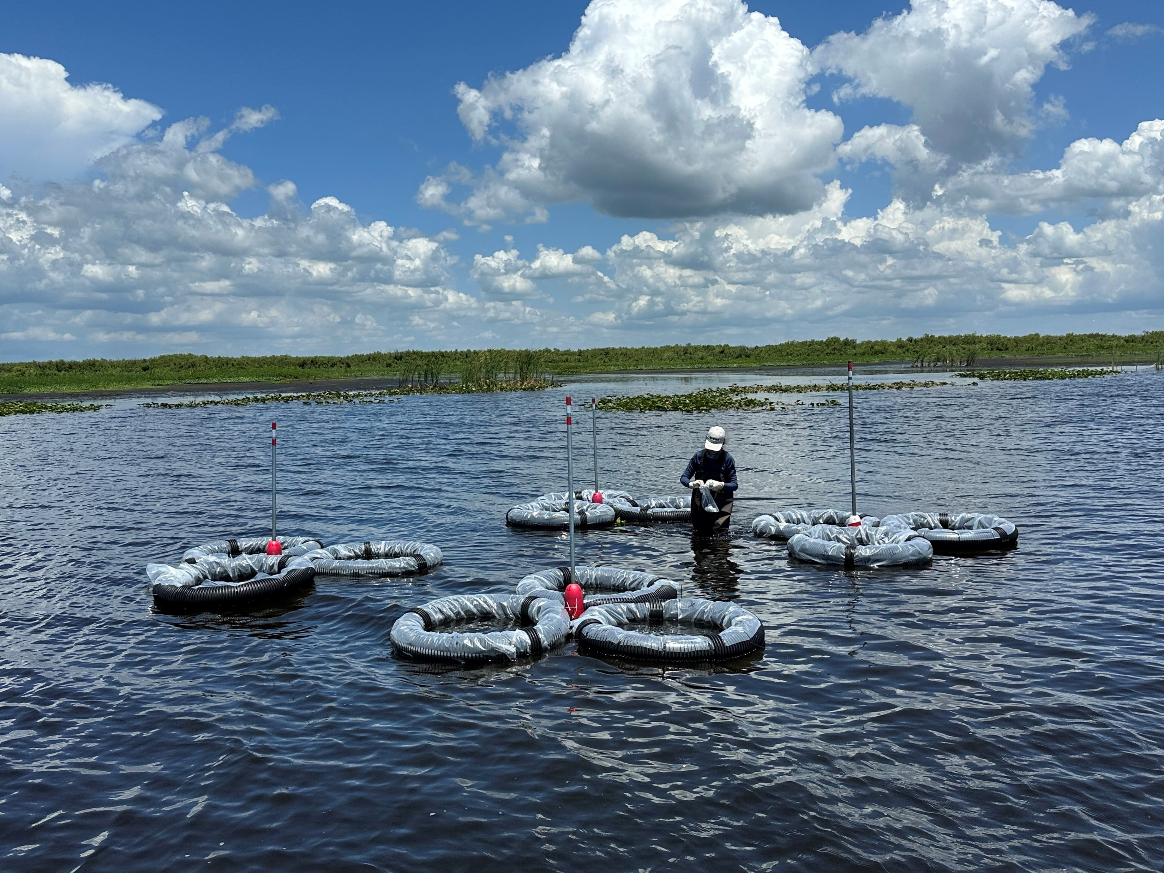
What’s Next?
Mesocosm project to isolate effects of planktivorous fish on the relationship between zooplankton and phytoplankton
Nutrient component included to quantify which force(s) are most affecting this relationship
Microzooplankton
Nutrients + Light
Phytoplankton
Planktivorous Fish
Wading Birds, Sportfish, etc.
Macrozooplankton
Notes:
Discuss the mesocosm project here and the ways it relates to this project, as well as the implications for Lake Okeechobee.

Slide 13




Thank You!
Global Ecology Research Group Lab at the University of Florida
South Florida Water Management District
Florida Chapter of The Wildlife Society

